Slide 1
Why Did You Choose CSE?

Slide 2
Introduce With Structural Programming Language
Course Title :- Structured Programming Language Sessional
Course Code :- CSE-122
Level Term: 1-II-A(G1, G2) & 1-II-B(G3, G4)
Khandaker Jannatul Ritu, Lecturer(CSE), BAIUST

Slide 3
Content Of This Lecture

Slide 4
Resources will be followed:
Books:
C: the complete reference
Programming in ANSI-C
C programming by tamim shahriar subin
52 Programming Problem Tamim Shahriar Subeen
Websites:
https://codeforces.com/group/MWSDmqGsZm/contests
https://judge.beecrowd.com/en/problems/index/1
YouTube Tutorials to follow(click on the link):-
C Programming Bangla Tutorials (সবার জন্য সি প্রোগ্রামিং) | Updated in 2023 - YouTube
Khandaker Jannatul Ritu, Lecturer(CSE), BAIUST

Slide 5

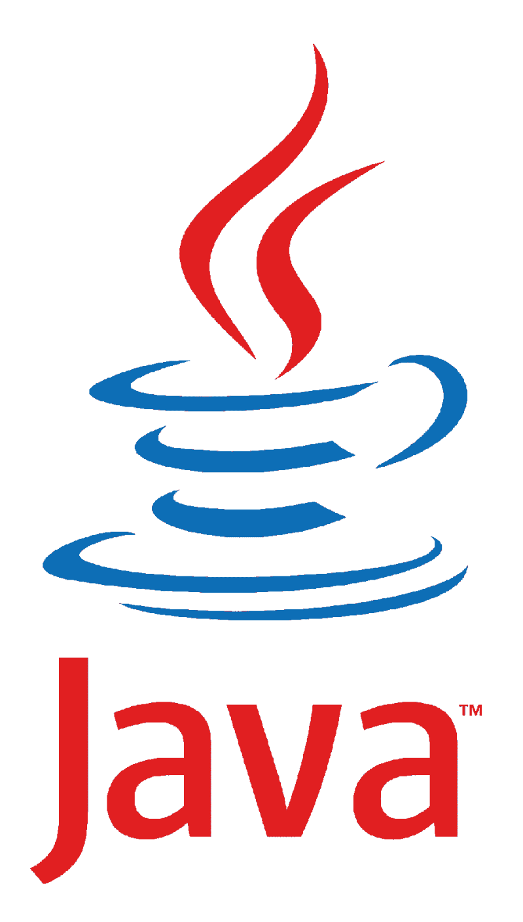





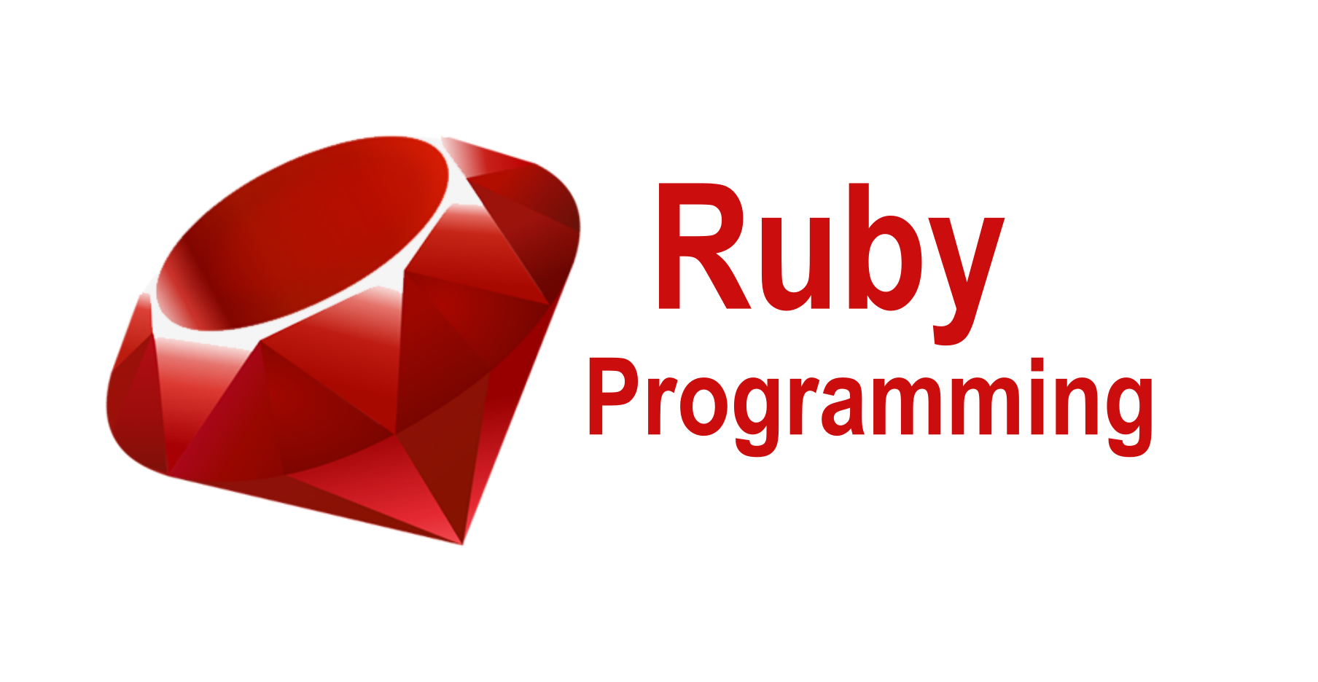
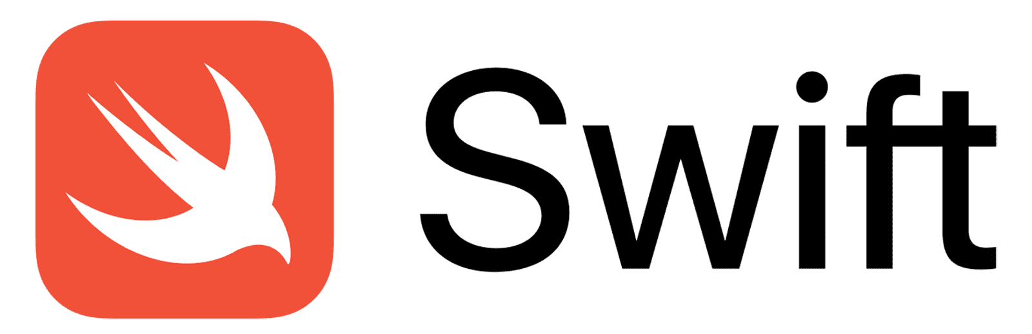
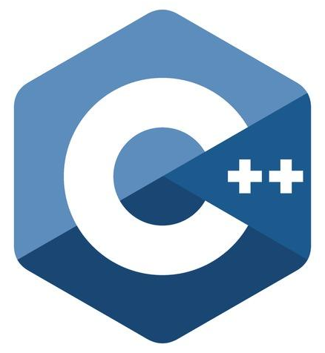
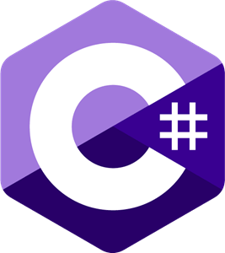

Popular Programming languages
Khandaker Jannatul Ritu, Lecturer(CSE), BAIUST

Slide 6












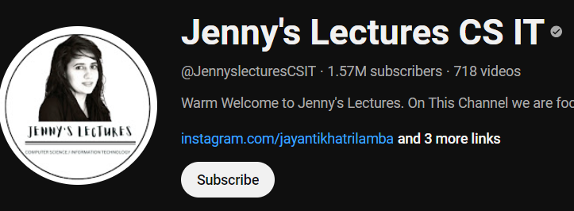




Necessary Websites & Tools Related To Programming

Slide 7











Competitive Programming OJ

Slide 8











Necessary Websites & Tools Related To Programming

Slide 9
General Overview of a Simple C Program's Structure:
Header Files
Main Function
Variable Declarations
Statements and Expressions
Comments
Return Statement
Functions
Standard Input/Output
#include <stdio.h>
int main()
{
//My First C Program
printf(“Hello Student’s!!!");
return 0;
}
Khandaker Jannatul Ritu, Lecturer(CSE), BAIUST

Slide 10
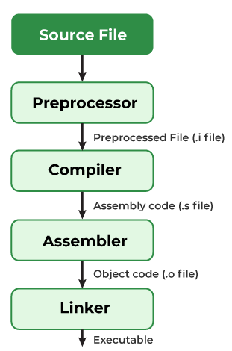
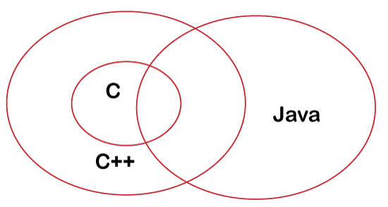
Compilation process in C
Differences Between C, C++ and Java
Khandaker Jannatul Ritu, Lecturer(CSE), BAIUST

Slide 11
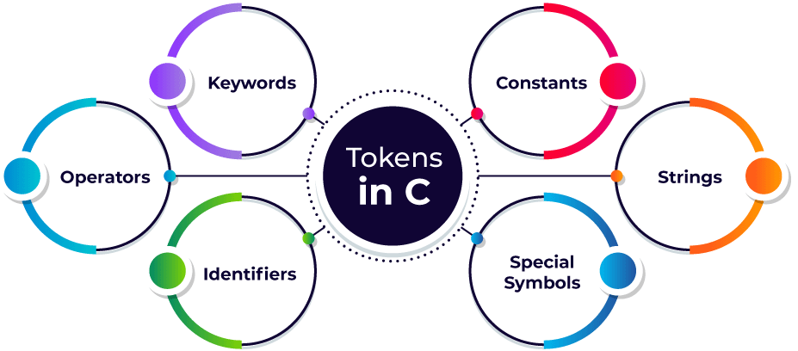
Tokens in C
A token in C is the meaningful smallest unit used in a C program.
Keywords in C
Keywords are predefined or reserved words
auto | break | case | char | const | continue | default | do
double | else | enum | extern | float | for | goto | if
int | long | register | return | short | signed | sizeof | static
struct | switch | typedef | union | unsigned | void | volatile | while
Khandaker Jannatul Ritu, Lecturer(CSE), BAIUST

Slide 12
C Comments
C Output (Print Text)
Single-line Comment in C
Syntax of Single Line C Comment
// This is a single line comment
#include<stdio.h>
int main()
{
printf("Hello Friends!");
printf("I am Learning C");
printf("And It is not awesome!");
}
output:
Hello Friends!I am Learning CAnd It is not awesome!
2. Multi-line Comment in C
Syntax of Multi-Line C Comment
/*Comment starts
continues
continues
.
.
.
Comment ends*/
Khandaker Jannatul Ritu, Lecturer(CSE), BAIUST

Slide 13
Escape Sequence in C
Escape Sequence | Name | Description
\n | New Line | It moves the cursor to the start of the next line.
\t | Horizontal Tab | It inserts some whitespace to the left of the cursor and moves the cursor accordingly.
\\ | Backlash | Use to insert backslash character.
\’ | Single Quote | It is used to display a single quotation mark.
\” | Double Quote | It is used to display double quotation marks.
\? | Question Mark | It is used to display a question mark.
An escape sequence contains a backslash (\) symbol followed by one of the escape sequence characters or an octal or hexadecimal number.
Khandaker Jannatul Ritu, Lecturer(CSE), BAIUST

Slide 14
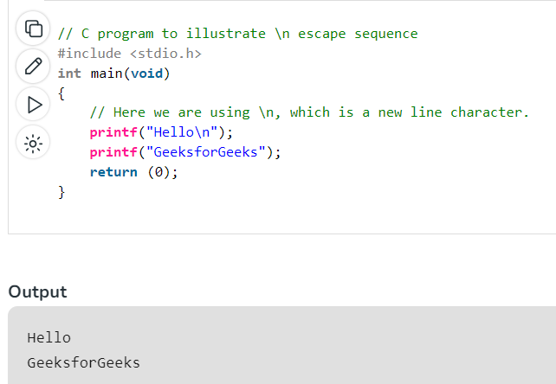
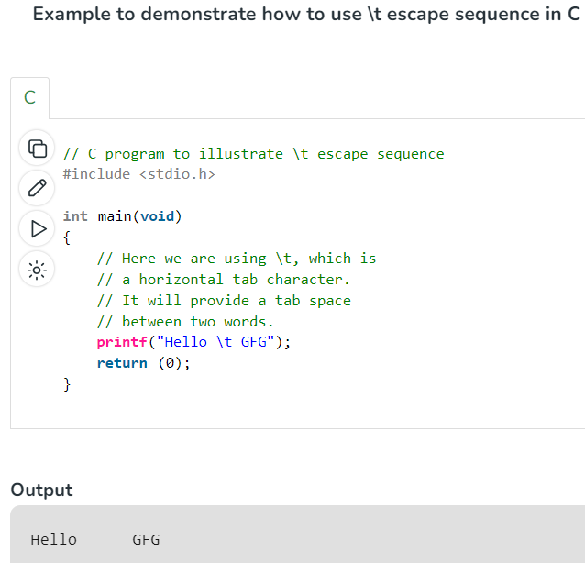
Escape Sequence in C
What is \n exactly?
The newline character (\n) is called an escape sequence, and it forces the cursor to change its position to the beginning of the next line on the screen. This results in a new line.
Khandaker Jannatul Ritu, Lecturer(CSE), BAIUST

Slide 15
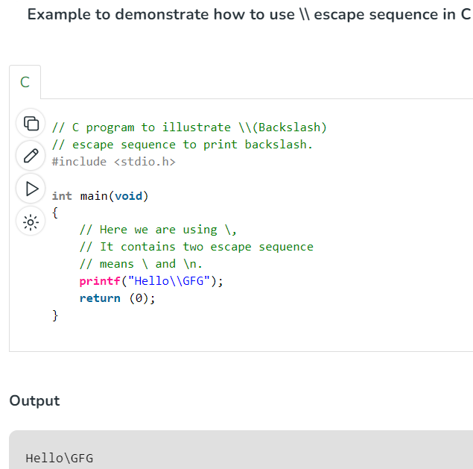
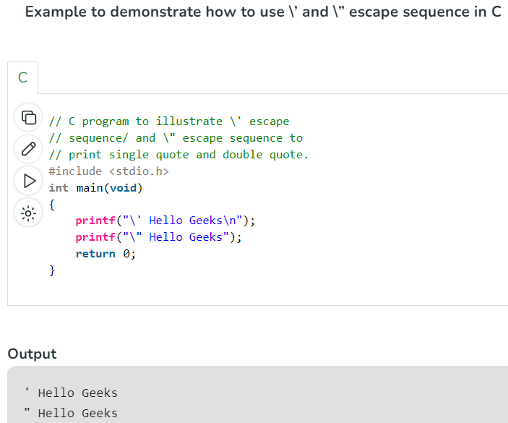
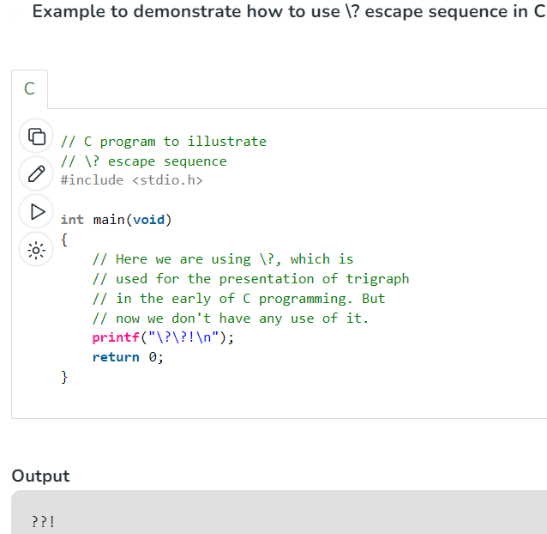
Escape Sequence in C
Khandaker Jannatul Ritu, Lecturer(CSE), BAIUST

Slide 16
Introduce With Variables, Constants, Literals

Slide 17
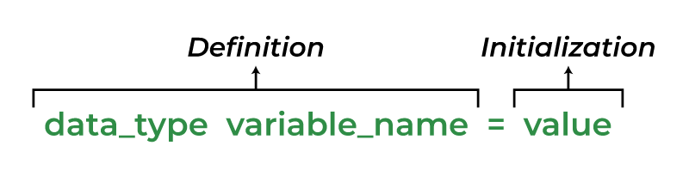
C Variables
Variables are containers for storing data values, like numbers and characters.
In C, there are different types of variables (defined with different keywords), for example:
int - stores integers (whole numbers), without decimals, such as 123 or -123
float / double - stores floating point numbers, with decimals, such as 19.99 or -19.99
char/strings - stores single characters, such as 'a' or 'B'. Characters are surrounded by single quotes
int main()
{
int age = 45;
float height = 5.5;
double weight = 56.3;
char genaration='z';
char name[50]="programming";
printf("%d\n", age);
printf("%f\n", height);
printf("%lf\n", weight);
printf("%c\n", genaration);
printf("%s\n", name);
}
Output:
45
5.500000
56.300000
z
programming
The syntax to declare a variable:
Khandaker Jannatul Ritu, Lecturer(CSE), BAIUST

Slide 18
C Identifiers
Identifiers are unique names that are assigned to variables, structs, functions, and other entities.
Rules to Name an Identifier in C
An identifier can include letters (a-z or A-Z), and digits (0-9).
An identifier cannot include special characters(/,<,>,*,!,~,#,@,$,%,^,&,*) except the ‘_’ underscore.
Spaces are not allowed while naming an identifier.
An identifier can only begin with an underscore or letters.
We cannot name identifiers the same as keywords because they are reserved words to perform a specific task. For example, printf, scanf, int, char, struct, etc.
The identifier must be unique in its namespace.
C language is case-sensitive so, ‘name’ and ‘NAME’ are different identifiers.
✅ Number, num=2, val, VAL=23, number1,number2, a1,a2,
❌ 1num, #val, ^list, $name, ~age, &age
✅ _num1, num1_, customer_list, customer_list1
❌ 1num_, customer-list, 1_num,
✅ customer_list
❌ customer list
✅ INT, PRINTF, CHAR
❌ int = 0, printf=0,
✅ name=0, NAME=0, Name=0, NaMe=0, NAMe=0,namE=0
Khandaker Jannatul Ritu, Lecturer(CSE), BAIUST

Slide 19
C Variable Types
1. Local Variable
2. Global Variable
3. Static Variable
#include<stdio.h>
float cp =10.5; //global variable
static int age = 34; //static global variable
int main()
{
float cp = 34; //local variable
static int myVariable=12; // static variable
}
Q1. If Local & global variable is same, then which variable will be executed?
Q2. If Local & global variable is same, then how to print the global variable in c?
Q3. List Some other variables and learn how they work.
Khandaker Jannatul Ritu, Lecturer(CSE), BAIUST

Slide 20
C Variable Values: Copying Variables
int main(){
int id1, id2, id3;
int a,b,c,d;
///type=1
id1 = 5;
id2 = 102;
id3 = id2;
id2 = id1;
id1 = id2;
printf("id1 = %d\n", id1);
printf("id2 = %d\n", id2);
printf("id3 = %d\n\n", id3);
///type=2
a = 61;
a = 23;
printf("a = %d\n\n", a);
a = 78;
a = 32;
printf("a = %d\n\n", a);
}
Change Variable Values.
If you assign a new value to an existing variable,
it will overwrite the previous value
Khandaker Jannatul Ritu, Lecturer(CSE), BAIUST

Slide 21
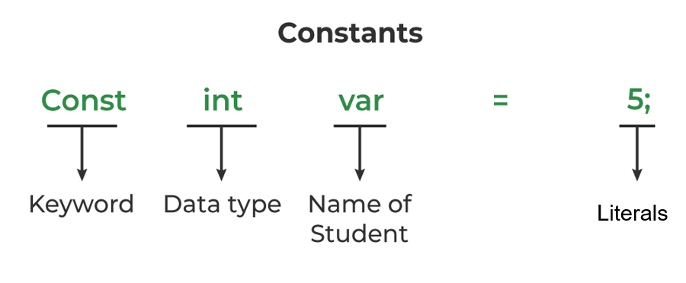
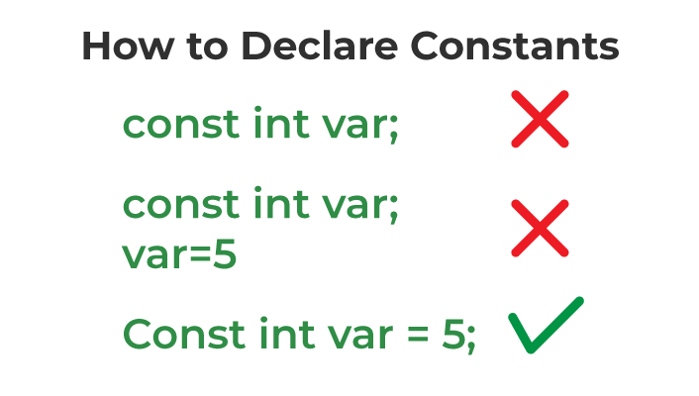
Constants & Literals in C : Unchangeable Variable
If you don't want others (or yourself) to change existing variable values, you can use the const keyword.
#include <stdio.h>
int main() {
const int myNum = 15; // myNum will always be 15
myNum = 10; // error: assignment of read-only variable 'myNum'
printf("%d", myNum);
return 0;
}
prog.c: In function 'main': prog.c:5:18: error: assignment of read-only variable 'myNum' 5 | myNum = 10; | ^
Properties of Constant in C
1. Initialization with Declaration
We can only initialize the constant variable in C at the time of its declaration. Otherwise, it will store the garbage value.
2. Immutability
The constant variables in c are immutable after its definition, i.e., they can be initialized only once in the whole program. After that, we cannot modify the value stored inside that variable.
Khandaker Jannatul Ritu, Lecturer(CSE), BAIUST

Slide 22
#include<stdio.h>
#define month 12
#define PI 3.1416
const int ar=15;
const float age=25.5;
const double d;
int main(){
const int ar=5;
//ar = 6; // cannot to change
printf("constant variable ar : %d\n\n", ar);
printf("constant variable age : %f\n\n", age);
scanf("%lf", &d);
printf("constant variable d : %lf\n\n", d);
//d =45;// cannot to change
printf("month : %d\n", month);
printf("value of pi : %f\n", PI);
}
Defining Constant using #define
#define const_name value
Khandaker Jannatul Ritu, Lecturer(CSE), BAIUST

Slide 23
Data Types In ‘C’
Data Types In ‘C’
Data Types In ‘C’
Khandaker Jannatul Ritu, Lecturer(CSE), BAIUST

Slide 24
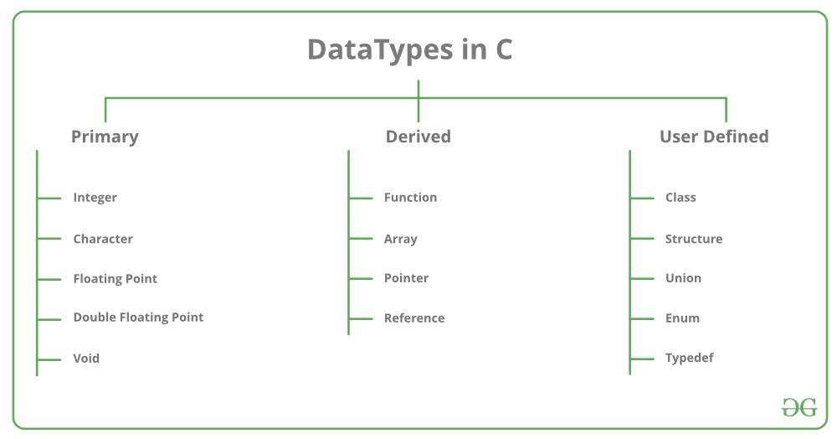
Data Types
Khandaker Jannatul Ritu, Lecturer(CSE), BAIUST

Slide 25
Data Type | Size (bytes) | Range | Format Specifier
short int | 2 | -32,768 to 32,767 | %hd
unsigned short int | 2 | 0 to 65,535 | %hu
unsigned int | 4 | 0 to 4,294,967,295 | %u
int | 4 | -2,147,483,648 to 2,147,483,647 | %d
long int | 4 | -2,147,483,648 to 2,147,483,647 | %ld
unsigned long int | 4 | 0 to 4,294,967,295 | %lu
long long int | 8 | -(2^63) to (2^63)-1 | %lld
unsigned long long int | 8 | 0 to 18,446,744,073,709,551,615 | %llu
char | 1 | -128 to 127 | %c
unsigned char | 1 | 0 to 255 | %c
float | 4 | 1.2E-38 to 3.4E+38 | %f
double | 8 | 1.7E-308 to 1.7E+308 | %lf
long double | 16 | 3.4E-4932 to 1.1E+4932 | %Lf
Khandaker Jannatul Ritu, Lecturer(CSE), BAIUST

Slide 26
Size of Data Types in C
int main()
{
int age = 45;
float height = 5.5;
double weight = 56.3;
char genaration='z';
char name[50]="programming";
printf("%d\n", sizeof(age));
printf("%d\n", sizeof(height));
printf("%d\n", sizeof(weight));
printf("%d\n", sizeof(genaration));
printf("%d\n", sizeof(name));
}
Output:
4
4
8
1
50
Khandaker Jannatul Ritu, Lecturer(CSE), BAIUST

Slide 27
Integer Data Type
Integer size 4bytes
1 byte = 8bit
4 byte = 8 * 4 bit = 32bit
If n=3
Memory will be store it as:- 00000000 00000000 00000000 00000011
1st byte
2nd byte
3rd byte
4th byte
Khandaker Jannatul Ritu, Lecturer(CSE), BAIUST

Slide 28
Data Type
int main()
{
int age = 45;
float height = 5.5;
double weight = 56.3;
char genaration='z';
char name[50]="programming";
printf("%d\n", age);
printf("%f\n", height);
printf("%lf\n", weight);
printf("%c\n", genaration);
printf("%s\n", name);
}
Output:
45
5.500000
56.300000
z
programming
#include<stdio.h>
int main()
{
float value1=34;
printf("%f", value1);
}
Output: ???
#include<stdio.h>
int main()
{
int value1=34.555454;
printf("%d", value1);
}
Output: ???
Khandaker Jannatul Ritu, Lecturer(CSE), BAIUST

Slide 29
C Decimal Precision
float vs. double
The precision of a floating point value indicates how many digits the value can have after the decimal point. The precision of float is six or seven decimal digits, while double variables have a precision of about 15 digits. Therefore, it is often safer to use double for most calculations - but note that it takes up twice as much memory as float (8 bytes vs. 4 bytes).
If you want to remove the extra zeros (set decimal precision), you can use a dot (.) followed by a number that specifies how many digits that should be shown after the decimal point:
#include <stdio.h>
int main()
{
float myFloatNum = 3.5;
printf(“ %f \n", myFloatNum); // Default will show 6 digits
printf(“ %.1f \n", myFloatNum); // Only show 1 digit
printf(“ %.2f \n", myFloatNum); // Only show 2 digits
printf(“ %.4f ", myFloatNum); // Only show 4 digits
}
Output:
3.500000
3.5
3.50
3.5000
Scientific Numbers
A floating point number can also be a scientific number with an "e" to indicate the power of 10:
#include <stdio.h>
int main()
{
float f1 = 35e3;
printf("%f\n", f1);
}
Output: ?????
Khandaker Jannatul Ritu, Lecturer(CSE), BAIUST

Slide 30
C Input/Output
C Input/Output
C Input/Output
Khandaker Jannatul Ritu, Lecturer(CSE), BAIUST

Slide 31
Basic Input and Output in C
scanf()
Syntax:
scanf("%X", &variable);
printf()
Syntax:
printf("%X", variable);
Integer:
Input: scanf("%d", &intVariable);
Output: printf("%d", intVariable);
Float:
Input: scanf("%f", &floatVariable);
Output: printf("%f", floatVariable);
Double:
Input: scanf("%lf", &doubleVariable);
Output: printf("%lf", doubleVariable);
Character:
Input: scanf("%c", &charVariable);
Output: printf("%c", charVariable);
String word:
Input: scanf("%s", &stringVariable);
Output: printf("%s", stringVariable);
String sentence
Input: scanf("%[^\n]s", &stringVariable);
Output: printf("%s", stringVariable);
Khandaker Jannatul Ritu, Lecturer(CSE), BAIUST

Slide 32
//Taking all Inputs
int main()
{
int num; float f; double d;
printf("Enter the integer: ");
scanf("%d", &num);
printf("\nEntered integer is: %d", num);
printf("\n\nEnter the float: ");
scanf("%f", &f);
printf("\nEntered float is: %f", f);
printf("\n\nEnter the double: ");
scanf("%lf", &d);
printf("\nEntered float is: %lf", d);
}
Output:
Enter the integer: 45
Entered integer is: 45
Enter the float: 4.5
Entered float is: 4.500000
Enter the double: 4.03
Entered float is: 4.030000
// Input/Output of a Sentences
#include <stdio.h>
int main()
{
char str[50];
// --- String ---To read a Sentence
// Input the Sentence
printf("\nEnter the Sentence: ");
scanf("%[^\n]s", str);
// Output the String
printf("\nEntered Sentence is: %s\n\n", str);
return 0;
}
Output:
Enter the Sentence: we are learning c-programming language
Entered Sentence is: we are learning c-programming language
// input and output of a character
#include <stdio.h>
int main()
{
char ch;
// Input the Character
printf("\nEnter the Character: ");
scanf("%c", &ch);
// Output the Character
printf("\nEntered character is: %c\n\n", ch);
}
Output:
Enter the Character: ritu
Entered character is: r
// input and output of a word
#include <stdio.h>
int main()
{
char str[50];
printf("Enter the Word: ");
scanf("%s", str);
printf("\nEntered Word is: %s", str);
}
Output:
Enter the Word: computer science
Entered Word is: computer
Khandaker Jannatul Ritu, Lecturer(CSE), BAIUST

Slide 33
Formatted and Unformatted Input/Output functions in C with Examples
Formatted I/O Functions
Formatted I/O functions are used to take various inputs from the user and display multiple outputs to the user. These types of I/O functions can help to display the output to the user in different formats using the format specifiers. These I/O supports all data types like int, float, char, and many more.
Why they are called formatted I/O? These functions are called formatted I/O functions because we can use format specifiers in these functions and hence, we can format these functions according to our needs.
The following formatted I/O functions will be discussed in this section-
printf()
scanf()
sprintf()
sscanf()
int main()
{
int num1;
// Printing a message on
// the output screen
printf("Enter a integer number: ");
// Taking an integer value
// from keyboard
scanf("%d", &num1);
// Displaying the entered value
printf("You have entered %d", num1);
}
Khandaker Jannatul Ritu, Lecturer(CSE), BAIUST

Slide 34
Unformatted Input/Output functions
Unformatted I/O functions are used only for character data type or character array/string and cannot be used for any other datatype. These functions are used to read single input from the user at the console and it allows to display the value at the console.
Why they are called unformatted I/O?
These functions are called unformatted I/O functions because we cannot use format specifiers in these functions and hence, cannot format these functions according to our needs.
The following unformatted I/O functions will be discussed in this section-
getch()
getche()
getchar()
putchar()
gets()
puts()
putch()
#include <conio.h>
#include <stdio.h>
int main()
{
char name[50];
puts("Please enter some texts: ");
gets(name);
puts(name);
getch();
}
Khandaker Jannatul Ritu, Lecturer(CSE), BAIUST

Slide 35
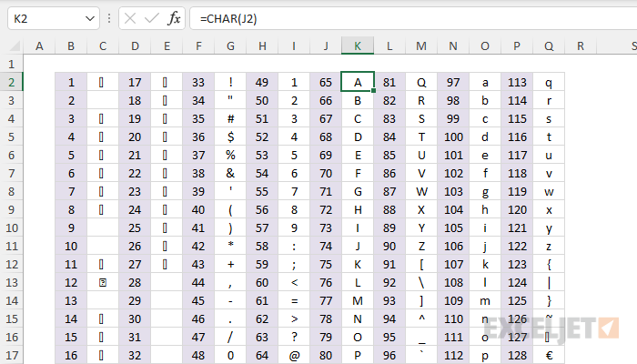
ASCII characters:

Slide 36
Q. Character → ASCII → Character
#include<stdio.h>
int main(){
/// character --> ascii value
char ch;
printf(" Enter a ascii characters: ");
scanf("%c", &ch);
printf(" corresponding value : %d\n\n", ch);
///ascii value --> character
int a;
printf(" Enter a value: ");
scanf("%d", &a);
printf(" corresponding ascii character : %c\n", a);
}
Q.Lowercase → Uppercase → Lowercase
#include<stdio.h>
int main(){
///lower to upper
char lower;
printf("Enter a letter between (a-z): ");
scanf("%c", &lower);
printf("uppercase method-1 : %c\n", (lower - 32));
printf("uppercase method-2 : %c\n\n", toupper(lower));
getchar();
///lower to upper
char upper;
printf("Enter a letter between (A-Z): ");
scanf("%c", &upper);
printf("uppercase method-1 : %c\n", (upper + 32));
printf("uppercase method-2 : %c\n\n", tolower(upper));
}
Enter a ascii characters: T
corresponding value : 84
Enter a value: 83
corresponding ascii character : S
Enter a letter between (a-z): a
uppercase method-1 : A
uppercase method-2 : A
Enter a letter between (A-Z): R
uppercase method-1 : r
uppercase method-2 : r

Slide 37
Boolean in C
Syntax: bool variable_name;
#include <stdbool.h> // Import the boolean header file
#include <stdio.h>
int main() {
printf("%d\n", 10 == 10); // Returns 1 (true), because 10 is equal to 10
printf("%d\n", 10 == 15); // Returns 0 (false), because 10 is not equal to 15
printf("%d", 5 == 55); // Returns 0 (false) because 5 is not equal to 55
}
Output:
1
0
0
#include <stdio.h>
int main() {
int x = 10;
int y = 9;
printf("%d", x > y);
printf("%d", 10 > 9);
}
Output:
1
1
#include <stdio.h>
int main()
{
int myAge = 25;
int votingAge = 18;
printf("%d", myAge >= votingAge); // Returns 1 (true), meaning 25 year olds are allowed to vote!
}
Output:
1
Khandaker Jannatul Ritu, Lecturer(CSE), BAIUST

Slide 38
Boolean in C
Therefore, you must use the %d format specifier to print a boolean value:
#include <stdio.h>
#include <stdbool.h>
int main()
{
bool isProgrammingFun = true;
bool isFishTasty = false;
printf("%d\n", isProgrammingFun);
printf("%d", isFishTasty);
}
Output:
1
0
Solve this!!
Q. Write the output for the following code:
int main ()
{
int x = 10;
int y = 9;
bool a = false, b = false;
printf("%d %d %d %d %d %d\n", x > y, x >= y, 13>=13, a==b, a>=b, a<=b );
printf("%d %d %d %d\n", 10 != 10, 10 == 15, x != y, x <= y);
}
#include <stdio.h>
#include <stdbool.h>
int main() {
bool isHamburgerTasty = true;
bool isPizzaTasty = true;
printf("%d", isHamburgerTasty == isPizzaTasty);
}
Output: 1
Khandaker Jannatul Ritu, Lecturer(CSE), BAIUST

Slide 39
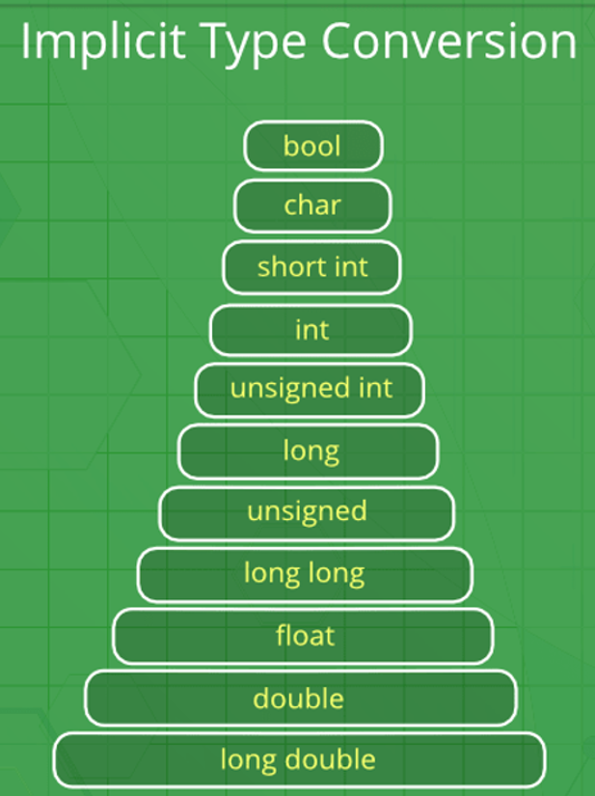
Type Conversion in C
Type conversion in C is the process of converting one data type to another.
There are two types of Conversion:
Implicit Type Conversion
A. Done by the compiler on its own, without any external trigger from the user.
B. Generally takes place when in an expression more than one data type is present. In such conditions type conversion (type promotion) takes place to avoid loss of data.
C. All the data types of the variables are upgraded to the data type of the variable with the largest data type.
D. It is possible for implicit conversions to lose information, signs can be lost (when signed is implicitly converted to unsigned), and overflow can occur (when long is implicitly converted to float).
bool → char → int → long long → float → double → long double
Khandaker Jannatul Ritu, Lecturer(CSE), BAIUST

Slide 40
Sometimes, you have to convert the value of one data type to another type. This is known as type conversion.
For example, if you try to divide two integers, 5 by 2, you would expect the result to be 2.5. But since we are working with integers (and not floating-point values), the following example will just output 2:
#include <stdio.h>
int main() {
int x = 5;
int y = 2;
int sum = 5 / 2;
printf("%d", sum);
return 0;
}
output: 2
Implicit conversion is done automatically by the compiler when you assign a value of one type to another.
For example, if you assign an int value to a float type:
Example
// Automatic conversion: int to float
float myFloat = 9;
printf("%f", myFloat); // 9.000000
As you can see, the compiler automatically converts the int value 9 to a float value of 9.000000.
This can be risky, as you might lose control over specific values in certain situations.
Khandaker Jannatul Ritu, Lecturer(CSE), BAIUST

Slide 41
Example of Type Implicit Conversion
// An example of implicit conversion
#include <stdio.h>
int main()
{
int x = 10; // integer x
char y = 'a'; // character c
// y implicitly converted to int. ASCII
// value of 'a' is 97
x = x + y;
// x is implicitly converted to float
float z = x + 1.0;
printf("x = %d, z = %f", x, z);
}
Especially if it was the other way around - the following example automatically converts the float value 9.99 to an int value of 9:
Example
// Automatic conversion: float to int
int myInt = 9.99;
printf("%d", myInt); // 9
What happened to .99? We might want that data in our program! So be careful. It is important that you know how the compiler work in these situations, to avoid unexpected results.
Output
x = 107, z = 108.000000
Khandaker Jannatul Ritu, Lecturer(CSE), BAIUST

Slide 42
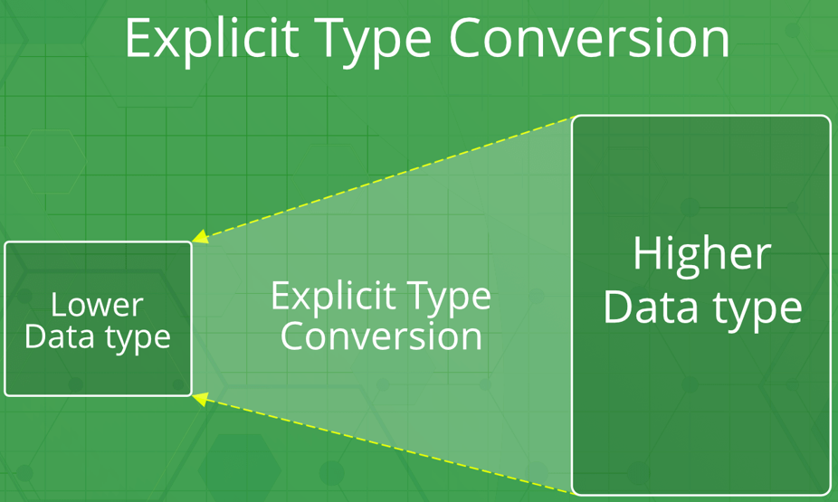
2. Explicit Type Conversion
This process is also called type casting and it is user-defined. Here the user can typecast the result to make it of a particular data type.
The syntax in C Programming:
(type) expression
Type indicated the data type to which the final result is converted.
Explicit conversion is done manually by placing the type in parentheses () in front of the value.
Considering our problem from the example above, we can now get the right result:
Example
// Manual conversion: int to float
float sum = (float) 5 / 2;
printf("%f", sum); // 2.500000
Khandaker Jannatul Ritu, Lecturer(CSE), BAIUST

Slide 43
// C program to demonstrate explicit type casting
#include<stdio.h>
int main()
{
double x = 1.2;
// Explicit conversion from double to int
int sum = (int)x + 1;
printf("sum = %d", sum);
return 0;
}
Output
sum = 2
You can also place the type in front of a variable:
int num1 = 5;
int num2 = 2;
float sum = (float) num1 / num2;
printf("%f", sum); // 2.500000
And since you learned about "decimal precision" in the previous chapter, you could make the output even cleaner by removing the extra zeros (if you like):
int num1 = 5;
int num2 = 2;
float sum = (float) num1 / num2;
printf("%.1f", sum); // 2.5
Khandaker Jannatul Ritu, Lecturer(CSE), BAIUST

Slide 44
Advantages of Type Conversion
Type safety:
Improved code readability:
Improved performance:
Improved compatibility
Improved data manipulation
Improved data storage
Disadvantages of type conversions in C programming:
Loss of precision: Converting data from a larger data type to a smaller data type can result in loss of precision, as some of the data may be truncated.
Overflow or underflow: Converting data from a smaller data type to a larger data type can result in overflow or underflow if the value being converted is too large or too small for the new data type.
Unexpected behavior: Type conversions can lead to unexpected behavior, such as when converting between signed and unsigned integer types, or when converting between floating-point and integer types.
Confusing syntax: Type conversions can have confusing syntax, particularly when using typecast operators or type conversion functions, making the code more difficult to read and understand.
Increased complexity: Type conversions can increase the complexity of your code, making it harder to debug and maintain.
Slower performance: Type conversions can sometimes result in slower performance, particularly when converting data between complex data types, such as between structures and arrays.
Khandaker Jannatul Ritu, Lecturer(CSE), BAIUST

Slide 45
Real-life Example Of Using Different Data Types
Here's a real-life example of using different data types, to calculate and output the total cost of a number of items:
#include <stdio.h>
int main() {
// Create variables of different data types
int items = 50;
float cost_per_item = 9.99;
float total_cost = items * cost_per_item;
char currency = '$';
// Print variables
printf("Number of items: %d\n", items);
printf("Cost per item: %.2f %c\n", cost_per_item, currency);
printf("Total cost = %.2f %c\n", total_cost, currency);
}
Khandaker Jannatul Ritu, Lecturer(CSE), BAIUST

Slide 46
Real-Life Example of type conversion
Here's a real-life example of data types and type conversion where we create a program to calculate the percentage of a user's score in relation to the maximum score in a game:
#include <stdio.h>
int main() {
// Set the maximum possible score to 500
int maxScore = 500;
// The actual score of the user
int userScore = 420;
// Calculate the percantage of the user's score in relation to the maximum available score
float percentage = (float) userScore / maxScore * 100.0;
// Print the percentage
printf("User's percentage is %.2f", percentage);
}
Output:
User's percentage is 84.00
Khandaker Jannatul Ritu, Lecturer(CSE), BAIUST

Slide 47
Online Judge Problems Based On this Lecture!
BeeCrowd:
https://judge.beecrowd.com/en/problems/view/1000
https://judge.beecrowd.com/en/problems/view/1001
https://judge.beecrowd.com/en/problems/view/1002
https://judge.beecrowd.com/en/problems/view/1003
https://judge.beecrowd.com/en/problems/view/1004
https://judge.beecrowd.com/en/problems/view/1005
https://judge.beecrowd.com/en/problems/view/1006
https://judge.beecrowd.com/en/problems/view/1007
https://judge.beecrowd.com/en/problems/view/1008
https://judge.beecrowd.com/en/problems/view/1009
https://judge.beecrowd.com/en/problems/view/1010
https://judge.beecrowd.com/en/problems/view/1011
https://judge.beecrowd.com/en/problems/view/1012
https://judge.beecrowd.com/en/problems/view/1014
CodeForces:
https://codeforces.com/group/MWSDmqGsZm/contest/219158/problem/A
https://codeforces.com/group/MWSDmqGsZm/contest/219158/problem/B
https://codeforces.com/group/MWSDmqGsZm/contest/219158/problem/C
https://codeforces.com/group/MWSDmqGsZm/contest/219158/problem/D
https://codeforces.com/group/MWSDmqGsZm/contest/219158/problem/E
https://codeforces.com/group/MWSDmqGsZm/contest/219158/problem/F

